Slide 1

The Missing M
Trainer markova.milica@gmail.com
Assistant ristopavlov@gmail.com
Notes:
Integrate Controller, View and Model

Slide 2
Module Contents
ASP.NET MVC
Model
Transfer Data From Controller To View
ViewBag
ViewData
TempData
Model
Model Decoration
Model vs ViewModel
Model Usage
Code academy @ Skopje, 2018-2019
Notes:
Models are represented by a class.
The Model is basically an entity that keeps data that is ready for use and change if necessary.
Model represents domain specific data and business logic in MVC architecture.
This means that the business logic dictates how the model will be structured as well as how many models do we need to create.
Domain or Core models stay in a separate place, usually in a separated project or in a separate folder.
So if we create a class with properties, that is actually the model and the properties are the data storage units.
The model is a _______ . Shape of data OR Collection of data
Model objects retrieve and store model state in the persistence store like a database.
Model class holds data in public properties.
All the Model classes reside in the Model folder in MVC folder structure.
Adding a Model - Right click on Model folder -> Add -> click on Class.
public class Order
{
public int Id { get; set; }
public int BillId { get; set; }
public double UserId { get; set; }
public virtual User User { get; set; }
public virtual Bill Bill { get; set; }
public virtual ICollection<PizzaOrder> PizzaOrders { get; set; }
}
public class Pizza
{
public int Id { get; set; }
public string Name { get; set; }
public virtual ICollection<Size> Sizes { get; set; }
public virtual ICollection<PizzaOrder> PizzaOrders { get; set; }
}

Slide 3
Transfer Data From Controller To View
ASP.NET MVC
ViewBag(dynamic)
ViewData
TempData
Model
Code academy @ Skopje, 2018-2019
Notes:
https://www.tutorialsteacher.com/mvc/integrate-controller-view-model
@Model
public IActionResult Index()
{
User person = new User() { FirstName = "Bob", LastName = "Bobsky", Address = "Bob Street", Phone = 0800234234 };
Order order = new Order(){ Id = 12, User = person, Pizza = "Kapri", Price = 10.5 }; return View(order);
}
Sending data to view without model : ViewBag, ViewData
public IActionResult Index()
{
User person = new User() { FirstName = "Bob", LastName = "Bobsky", Address = "Bob Street", Phone = 0800234234 };
Order order = new Order(){ Id = 12, User = person, Pizza = "Kapri", Price = 10.5 };
ViewData.Add("Title", "Home Page"); // ViewBag.Title = "Home Page";
ViewData.Add("Order", order); //ViewBag.Order = order;
return View();
}
// View
<h1>@ViewData["Title"]</h1>
// Will show up in our view
<ul>
// Will break on build time
<li>Name: @ViewData["Order"].User.FirstName</li> //<li>Name: @ViewBag.Order.User.FirstName</li>
<li>Pizza: @ViewData["Order"].Pizza</li> //<li>Pizza: @ViewBag.Order.Pizza</li>
<li>Price: @ViewData["Order"].Price</li>
<ul>
TempData

Slide 4
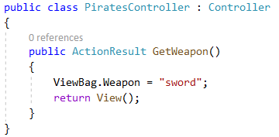

ViewBag
ASP.NET MVC
Allows you to share values dynamically to the view from the controller
A dynamic object without pre-set properties
Code academy @ Skopje, 2018-2019
Notes:
ViewBag only transfers data from controller to view, not visa-versa. ViewBag values will be null if redirection occurs.
The ViewBag's life only lasts during the current http request.
ViewBag values will be null if redirection occurs.

Slide 5
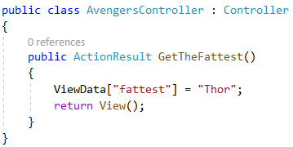
ViewData
ASP.NET MVC
A dictionary object to pass the data from Controller to View where data is passed in the form of key-value pair
Code academy @ Skopje, 2018-2019
Notes:
ViewData only transfers data from controller to view, not vice-versa. It is valid only during the current request.
ViewData is derived from ViewDataDictionary which is a dictionary type.
ViewData's life only lasts during current http request. ViewData values will be cleared if redirection occurs.
ViewData value must be type cast before use.
ViewBag internally inserts data into ViewData dictionary. So the key of ViewData and property of ViewBag must NOT match.

Slide 6
TempData
ASP.NET MVC
TempData is a dictionary object to pass the data from one action to other action in the same Controller or different Controllers
Usually, TempData object will be stored in a session object
TempData scope is limited to the next request and if we want Tempdata to be available even further, we should use Keep and peek
Code academy @ Skopje, 2018-2019

Slide 7
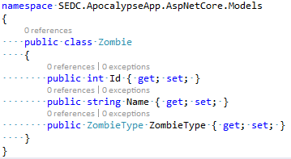
Model
ASP.NET MVC
Is a simple class with properties
Should not contain any server side logic
Code academy @ Skopje, 2018-2019
Notes:
<table class="table">
<tr>
<th> @Html.DisplayNameFor(model => model.Name) </th>
<th> @Html.DisplayNameFor(model => model.Size) </th>
<th></th>
</tr>
@foreach (var item in Model) {
<tr>
<td> @Html.DisplayFor(modelItem => item.Name) </td>
<td> @Html.DisplayFor(modelItem => item.Size) </td>
<td> @Html.ActionLink("Edit", "Edit", new { id=item.Id }) | @Html.ActionLink("Details", "Details", new { id=item.Id }) | @Html.ActionLink("Delete", "Delete", new { id = item.Id }) </td>
</tr>
}
</table>

Slide 8
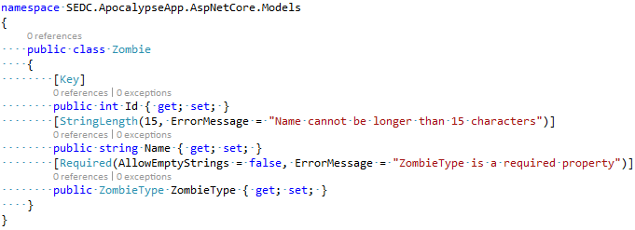
Model Decoration
ASP.NET MVC
Properties can be decorated using attributes
Code academy @ Skopje, 2018-2019
Notes:
https://www.tutorialsteacher.com/mvc/implement-validation-in-asp.net-mvc
In this section, you will learn how to implement data validations in the ASP.NET MVC application.
DataAnnotations
ASP.NET MVC uses DataAnnotations attributes to implement validations.
ASP.NET MVC framework will automatically enforce these validation rules and display validation messages in the view.
the MVC framework will automatically display the default error message
Required Indicates that the property is a required field
StringLength Defines a maximum length for string field
Range Defines a maximum and minimum value for a numeric field
RegularExpression Specifies that the field value must match with specified Regular Expression
CreditCard Specifies that the specified field is a credit card number
CustomValidation Specified custom validation method to validate the field
EmailAddress Validates with email address format
FileExtension Validates with file extension
MaxLength Specifies maximum length for a string field
MinLength Specifies minimum length for a string field
Phone Specifies that the field is a phone number using regular expression for phone numbers
Create the GET and POST Edit Action method
Try to Save edited values
check if the ModelState is valid or not
if (ModelState.IsValid)
ModelState.IsValid determines that whether submitted values satisfy all the DataAnnotation validation attributes applied to model properties.
Generate VIEW after model is designed
ASP.NET MVC uses DataAnnotations attributes for validation.
DataAnnotations attributes can be applied to the properties of the model class to indicate the kind of value the property will hold.
The following validation attributes available by default
Required
StringLength
Range
RegularExpression
CreditCard
CustomValidation
EmailAddress
FileExtension
MaxLength
MinLength
Phone
Use ValidationSummary to display all the error messages in the view.
Use ValidationMessageFor or ValidationMessage helper method to display field level error messages in the view.
Check whether the model is valid before updating in the action method using ModelState.IsValid.
Enable client side validation to display error messages without postback effect in the browser.

Slide 9
Model vs View Model
ASP.NET MVC
ViewModel is specific for a single View
Model can be reused for multiple views
Model example name: Author
ViewModel example name: AuthorWithBooks
Code academy @ Skopje, 2018-2019
Notes:
View models are classes that contain all the information that one view needs.
This means that this class can have properties from multiple models
The data first comes in the multiple domain models ( core, main models ) and then we map it to the view model to create a specific set of data needed for a view.
We must always mark down our view models by writing ViewModel at the end of the model name.

Slide 10
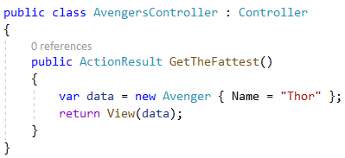

Model Usage
ASP.NET MVC
Code academy @ Skopje, 2018-2019

Slide 11
Demo
ASP.NET MVC
Create an action that uses all of the listed below:
ViewBag
ViewData
TempData
Model
Code academy @ Skopje, 2018-2019

Slide 12
?
ASP.NET MVC
Code academy @ Skopje, 2018-2019

